Slide 1
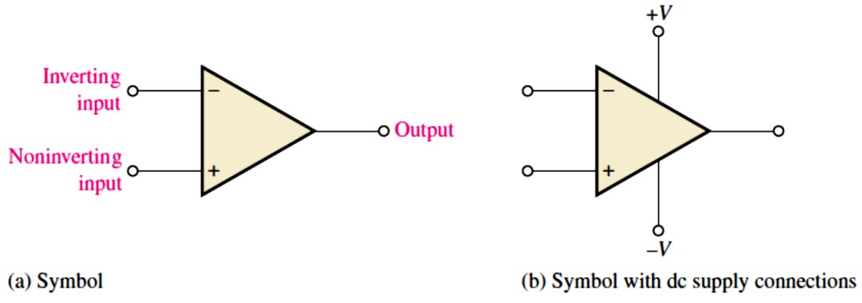
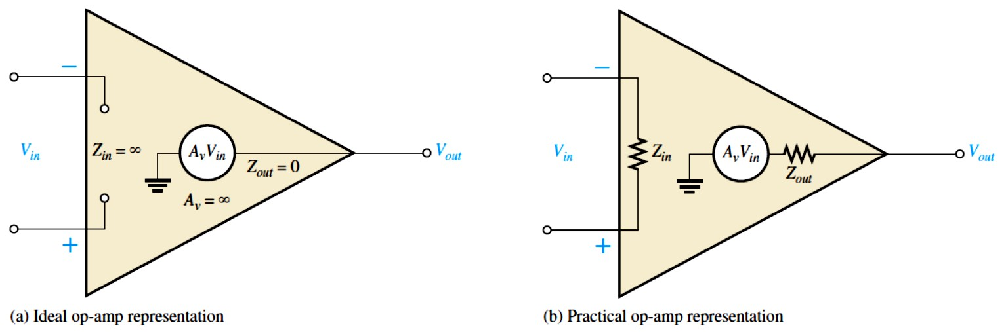
Lecture 12: The Operational Amplifier
In the previous Lectures, we have studied a number of important electronic devices.
  These devices, such as the diode and the transistor, are separate devices that are individually packaged and interconnected in a circuit with other devices to form a complete, functional unit. Such devices are referred to as discrete components.
Now we will begin the study of linear integrated circuits (ICs), where many transistors, diodes,
resistors, and capacitors are fabricated on a single tiny chip of semiconductive material and packaged in a single case to form a functional circuit.
In this Lecture, we will learn the basics of op-amps.
12.1 Introduction to Operational Amplifiers (op-amps)
Early op-amps were used primarily to perform mathematical operations such as addition, subtraction, integration, and differentiation—thus the term operational.
Today’s op-amps are ICs that use relatively low dc supply voltages and are reliable and inexpensive.
The basic op-amp is shown in Figure 12-1 and has three terminals not including power and ground: inverting (−) input, noninverting (+) input, and output.
A differential amplifier forms the input stage of an op-amp.
Most op-amps require both a positive and a negative dc supply voltage.
FIGURE 12-1: Op-amp symbols.
The Ideal Op-Amp: The ideal characteristics as illustrated in Figure 12-2(a) are: infinite input impedance, zero output impedance, infinite open-loop voltage gain, and infinite bandwidth.
FIGURE 12-2: Basic op-amp.

Slide 2
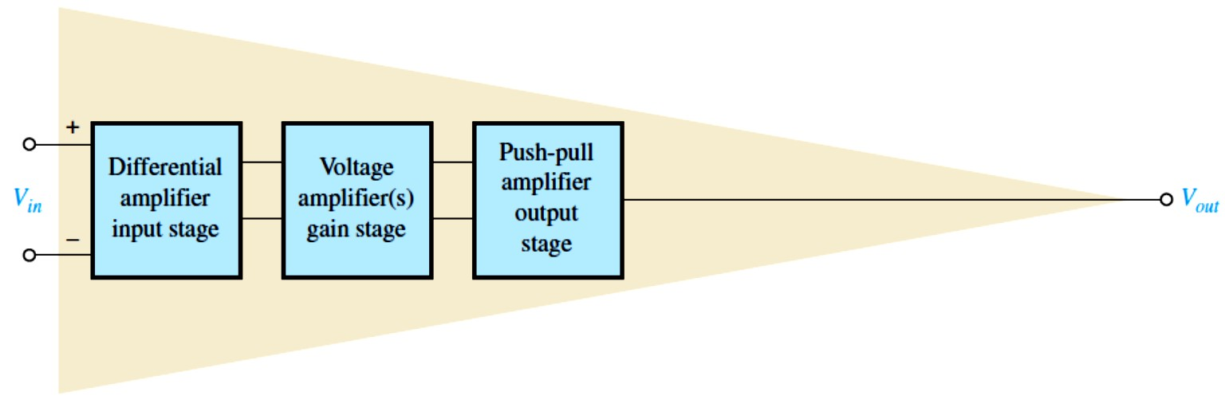
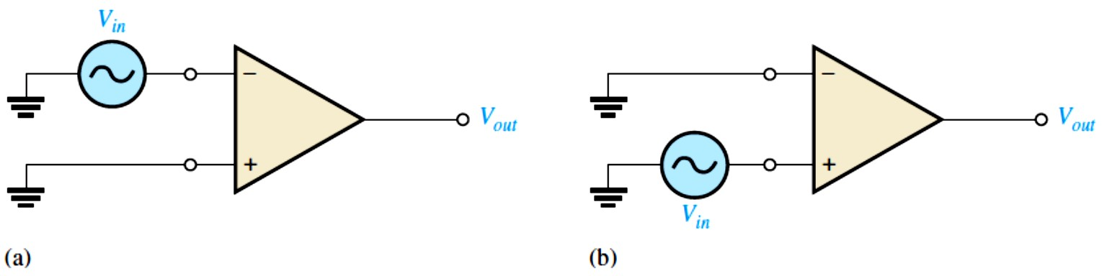
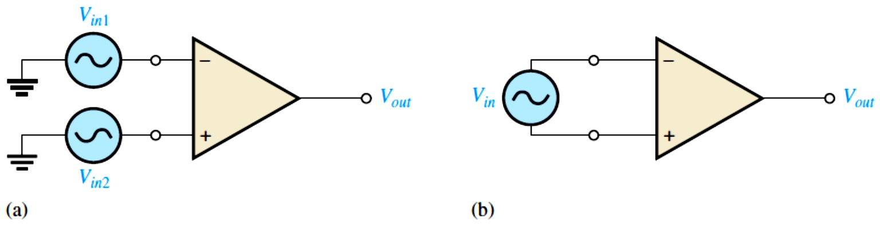
The Practical Op-Amp: The practical characteristics as labelled in Figure 12-2(b) are: very high input impedance, very low output impedance, and very high open-loop voltage gain.
Another practical consideration is that there is always noise generated within the op-amp.
  Noise is an undesired signal that affects the quality of a desired signal.
Internal Block Diagram of an Op-Amp: A typical op-amp is made up of three types of amplifier circuits: a differential amplifier, a voltage amplifier, and a push-pull amplifier, as
shown in Figure 12-3.
  The differential amplifier is the input stage for the op-amp. It provides amplification of the difference voltage between the two inputs. The second stage is usually a class A amplifier that provides additional gain. Some op-amps may have more than one voltage amplifier stage. A push-pull class B amplifier is typically used for the output stage.
FIGURE 12-3: Basic
internal arrangement of an op-amp.
12.2 OP-AMP Input Modes and Parameters
Two types of op-amp input operation are the differential mode and the common mode.
The input signal modes are determined by the differential amplifier input stage of the op-amp.
Differential Mode: either one signal is applied to an input with the other input grounded or two opposite-polarity signals are applied to the inputs as shown in Figures 12-4 and 12-5.
FIGURE 12-4: Single-ended differential mode.
FIGURE 12-5:
Double-ended differential mode.

Slide 3
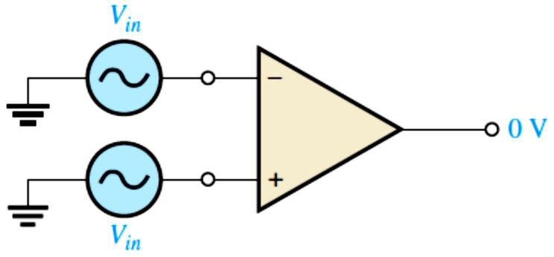
Common Mode: Common mode occurs when two signal voltages of the same phase, frequency, and amplitude are applied to the two inputs, as shown in Figure 12-6.
When equal input signals are applied to both inputs, they tend to cancel, resulting in a zero output voltage.
  This action is called common-mode rejection. Its importance lies in the situation where an
unwanted signal appears commonly on both op-amp inputs.
Common-mode rejection means that this unwanted signal (noise) will not appear on the output and distort the desired signal.
FIGURE 12-6: Common-mode operation.
Op-Amp Parameters: These parameters are:
Common-Mode Rejection Ratio (CMRR): is a measure of an op-amp’s ability to reject common-mode inputs (signals).
Ideally, an op-amp provides a very high gain for differential-mode signals and zero gain for common-mode signals.
Practical op-amps exhibit a very small common-mode gain, ��� (usually much less than 1), while providing a high open-loop differential voltage gain, ��� (usually several thousand).
Open-loop voltage gain (��� ) is the gain of an op-amp with no external feedback connections.
The higher the ��� with respect to the ���, the better the performance of the op-amp in terms of rejection of common-mode signals.
���� = ���⁄���
The CMRR is often expressed in decibels (dB) as
���� = �� 𝐥�𝐠(���⁄���)
Equation 12– 1
Equation 12– 2
EXAMPLE 12-1: A certain op-amp has an open-loop differential voltage gain of 100,000 and a common-mode gain of 0.2. Determine the CMRR and express it in decibels.
Solution ��� = 100,000, and ��� = 0.2. Therefore,
CMRR = ��� ⁄��� = 100,000⁄0.2 = 500,000
Expressed in decibels, CMRR = 20 log(500,000) = 114 dB
Maximum Output Voltage Swing (�_{�(�−�)}): When an input signal is applied, the ideal limits of the peak-to-peak output signal are ±�_{CC}. In practice, however, this ideal can be approached but never reached.�_{O(p−p)} varies with the load connected to the op-amp and increases directly with load resistance.

Slide 4
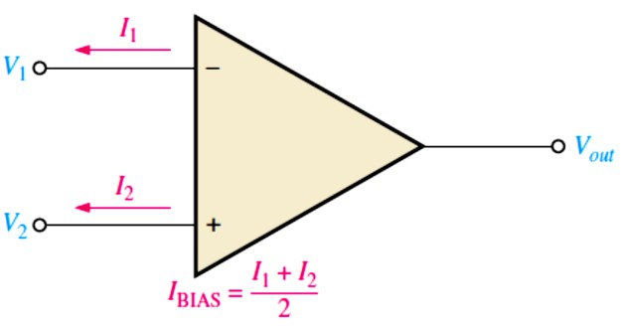
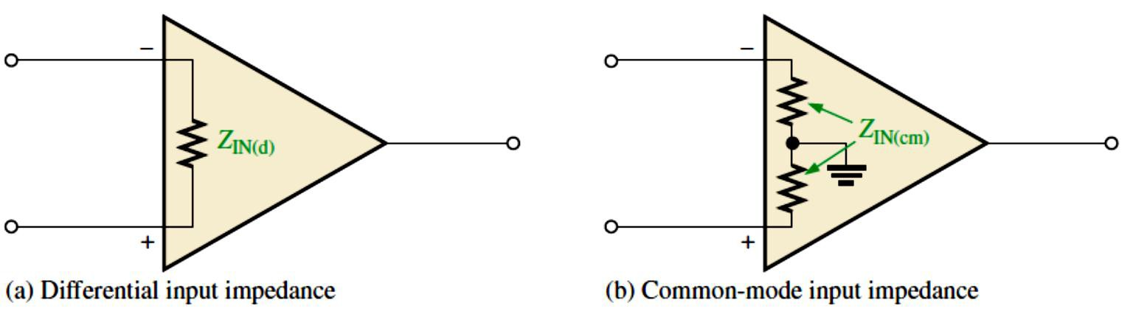
Input Offset Voltage (�_{OS}): produces an output error voltage (a small dc voltage, �_{OUT(error)}) (with no input voltage).
As specified on an op-amp datasheet, the �_{OS} is the differential dc voltage required between the inputs to force the output to zero volts. Typical values of input offset voltage are in the range of 2 mV or less. In the ideal case, it is 0 V.
Input Bias Current (𝑰_{�𝐈��}): also produces an output error voltage (with no input voltage).
The 𝑰_{�𝐈��} is the dc current required by the inputs of the amplifier to properly operate the first stage. By definition, the input bias current is the average of both input currents and is:
𝑰_{�𝐈��} = (𝑰� + 𝑰�)⁄�
Equation 12– 3
The concept of input bias current is illustrated in Figure 12-7.
FIGURE 12-7: Input bias current is the average of the two op-amp input currents.
Input Impedance: Two basic ways of specifying the input impedance of an op-amp are the differential and the common mode.
The differential input impedance is the total resistance between the inverting and the noninverting inputs and measured by determining the change in bias current for a given change in differential input voltage. It is as illustrated in Figure 12-8(a).
The common-mode input impedance is the resistance between each input and ground and is measured by determining the change in bias current for a given change in common-mode input voltage. It is depicted in Figure 12-8(b).
FIGURE 12-8: Op-amp input impedance.
Input Offset Current (I_{OS}): is the difference between the two input bias currents, expressed as an absolute value.
𝑰�� = |𝑰� − 𝑰�|
Equation 12– 4

Slide 5
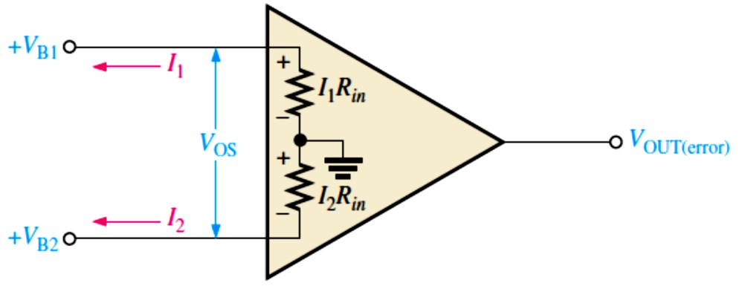
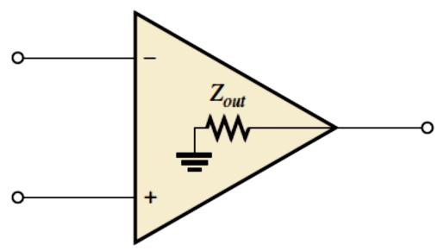
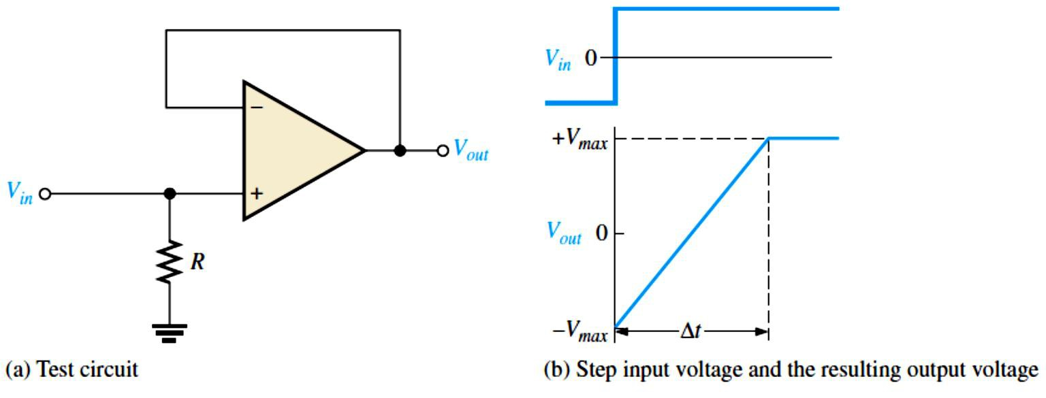
In many applications, the offset current can be neglected. However, high-gain, high-input impedance amplifiers should have as little 𝐼_{OS} as possible because the difference in currents through large input resistances develops a substantial offset voltage, as shown in Figure 12-9.
FIGURE 12-9: Effect of input offset current.
The offset voltage developed by the input offset current is
�_{OS} = �₁𝑅_{𝑖�} − 𝐼₂𝑅_{𝑖�} = (�₁ − 𝐼₂)𝑅_{𝑖�} = 𝐼_{OS}𝑅_{𝑖�}
Equation 12– 5
The error created by 𝐼_{OS} is amplified by the gain �� of the op-amp and appears in the output
�OUT(error) ^{= �}��OS ^{= �}�^{𝐼}OS^{𝑅}𝑖�
Equation 12– 6
Output Impedance: is the resistance viewed from the output terminal of the op-amp, as indicated in Figure 12-10.
FIGURE 12-10: Op-amp output impedance.
Slew Rate: is the rate in volts per microsecond at which the output voltage of an op-amp can change in response to a step input.
It is measured with an op-amp connected as shown in Figure 12-11. This particular op-amp connection is a unity-gain, noninverting configuration.
The width of the input pulse must be sufficient to allow the output to “slew” from its lower limit to its upper limit. A certain time interval, ∆𝑡, is required for the output voltage to go from
its lower limit −�_{�𝑎𝑥}to its upper limit +�_{�𝑎𝑥}, once the input step is applied. The slew rate is
�𝐥𝐞𝐰𝐫𝐚𝐭𝐞= ∆����⁄∆�
Equation 12– 7
where ∆���� = +�_{�𝑎𝑥}− ( −�_{�𝑎𝑥}). The unit of slew rate is volts per microsecond (V/𝜇s).
FIGURE 12-11:
Slew-rate measurement.

Slide 6
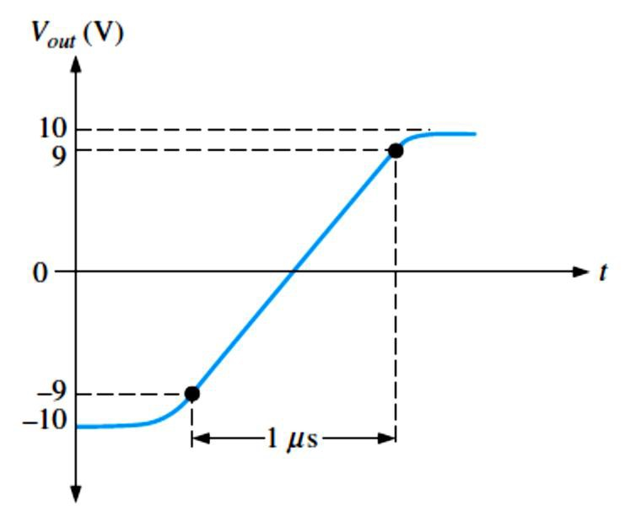
EXAMPLE 12-2: The output voltage of a certain op-amp appears as shown in Figure 12-12 in response to a step input. Determine the slew rate.
FIGURE 12-12
Solution The output goes from the lower to the upper limit in 1 𝜇s. Since this response is
not ideal, the limits are taken at the 90% points, as indicated. So, the upper limit is +9 V and the
lower limit is −9 V. The slew rate is
Slew rate =
∆����
+9 V − (−9 V)
= = 18 V⁄𝜇s
∆𝑡1 𝜇s
Frequency Response: The internal amplifier stages that make up an op-amp have voltage gains limited by junction capacitances.
Although the differential amplifiers used in op-amps are somewhat different from the basic amplifiers discussed earlier, the same principles apply. An op-amp has no internal coupling capacitors, however; therefore, the low-frequency response extends down to dc (0 Hz).
Noise Specification: Noise has become a more important issue in new circuit designs because of the requirement to run at lower voltages and with greater accuracy than in the past.
As little as two or three microvolts can create errors in analog-to-digital conversion.
Many sensors produce only tiny voltages that can be masked by noise.
As a result, unwanted noise from op-amps and components can degrade the performance of circuits.
Noise is defined as an unwanted signal that affects the quality of a desired signal. While interference from an external source (such as a nearby power line) qualifies as noise, for the
purpose of op-amp specifications, interference is not included. Only noise generated within the op-amp is considered in the noise specification. When the op-amp is added to a circuit,
additional noise contributions are added from other circuit elements, such as the feedback resistors or any sensors. For example, all resistors generate thermal noise—even one sitting in
the parts bin. The circuit designer must consider all sources within the circuit, but the concern here is the op-amp specification for noise, which only considers the op-amp.
There are two basic forms of noise. At low frequencies, noise is inversely proportional to the
frequency; this is called 1⁄𝑓noise or “pink noise”. Above a critical noise frequency, the noise becomes flat and is spread out equally across the frequency spectrum; this is called “white noise”.

Slide 7
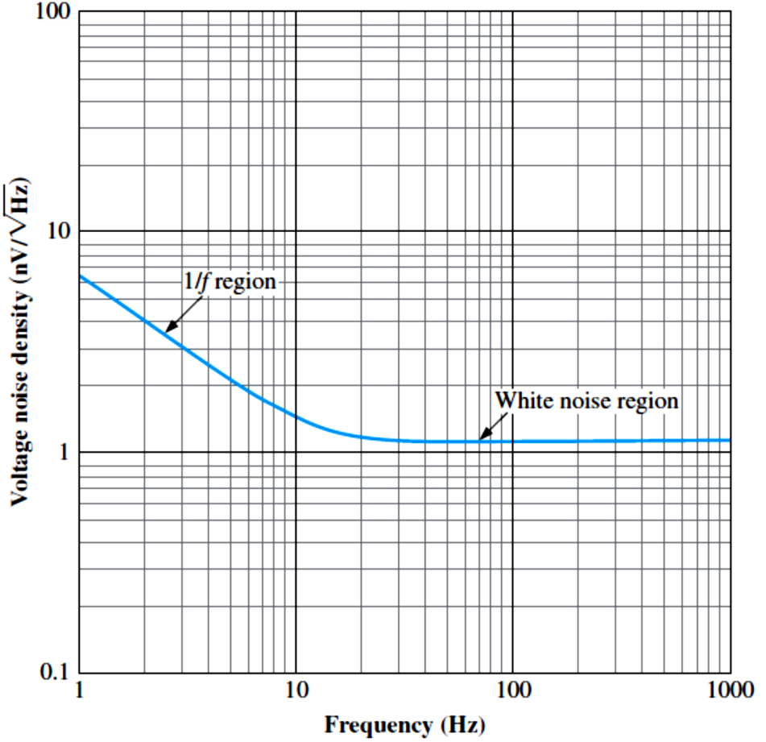
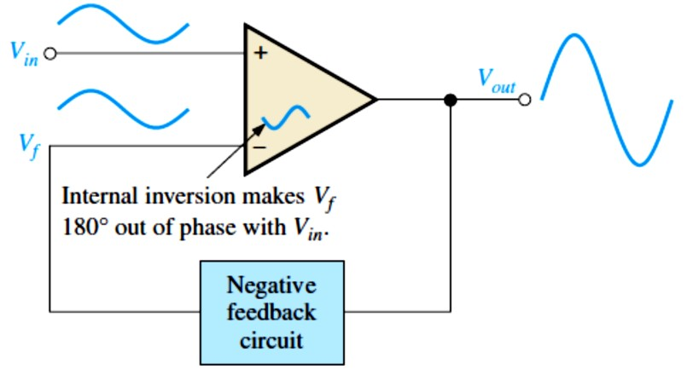
The power distribution of noise is measured in watts per hertz (W/Hz). Power is proportional to the square of the voltage, so noise voltage (density) is found by taking the square root of the noise power density, resulting in units of volts per square root hertz (V⁄√Hz).
For operational amplifiers, noise level is normally shown with units of n V⁄√Hz and is specified relative to the input at a specific frequency above the noise critical frequency. For example, a noise level graph for a very low-noise op-amp is shown in Figure 12-13; the specification for this op-amp will indicate that the input voltage noise density at 1 kHz is
1.1n V⁄√Hz. At low frequencies, the noise level is higher than this due to the 1⁄𝑓noise contribution as we can see from the graph.
FIGURE 12-13: Noise as a function of frequency for a typical op-amp.
12.3 Negative Feedback
Negative feedback, as illustrated in Figure 12-14, occurs when a portion of the output voltage is connected back to the inverting input such that it subtracts from the input voltage, thus reducing the voltage gain but increasing the stability and bandwidth.
FIGURE 12-14: Illustration of negative feedback.

Slide 8
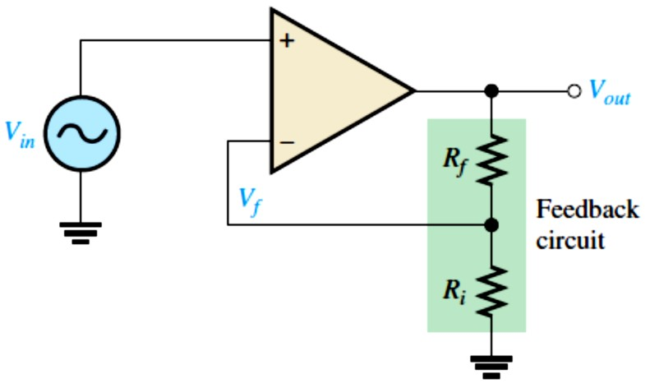
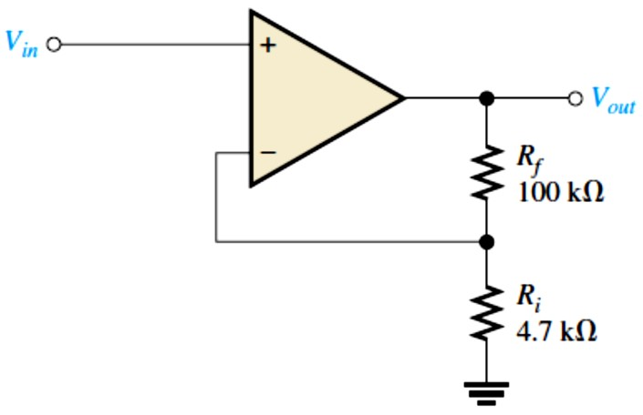
12.4 OP-AMPS with Negative Feedback
An op-amp can be connected using negative feedback to stabilize the gain and increase frequency response.
Negative feedback takes a portion of the output and applies it back out of phase with the input, creating an effective reduction in gain. This closed-loop gain is usually much less than the open-loop gain and independent of it.
There are three basic op-amp configurations: inverting, noninverting, and voltage-follower.
The three basic op-amp configurations employ negative feedback.
Noninverting Amplifier: An op-amp connected in a closed-loop configuration as a
noninverting amplifier with a controlled amount of voltage gain is shown in Figure 12-16.
Closed-Loop Voltage Gain, ���: is the voltage gain of an op-amp with external feedback.
The amplifier configuration consists of the op-amp and an external negative feedback circuit that connects the output to the inverting input.
�_{��(��)} = � + (𝑹_{𝒇}⁄𝑹_{𝒊})
Equation 12– 8
The attenuation, B, of the feedback circuit is � = 𝑅_{𝑖}⁄(𝑅_{𝑖}+ �_{𝑓})
FIGURE 12-16: Noninverting amplifier.
EXAMPLE 12-3: Determine the closed-loop voltage gain of the amplifier in Figure 12-17.
FIGURE 12-17
Solution This is a noninverting op-amp configuration. Therefore, the closed-loop voltage gain is
�_{𝑓}
100 kΩ
= 1 + = 22.3
4.7 kΩ
���(NI) ⁼ ¹ ⁺ _{𝑅}
𝑖
Voltage-Follower: is a special case of the noninverting amplifier where all of the output voltage is fed back to the inverting (−) input by a straight connection, as shown in Figure 12- 18.

Slide 9
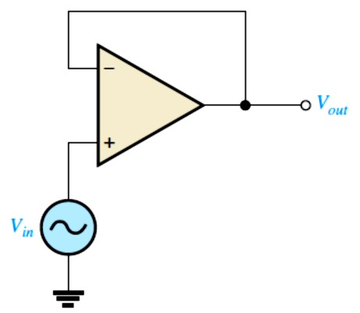
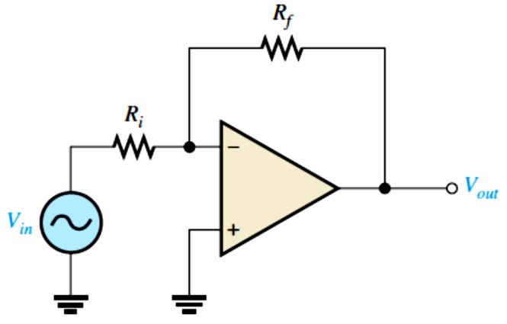
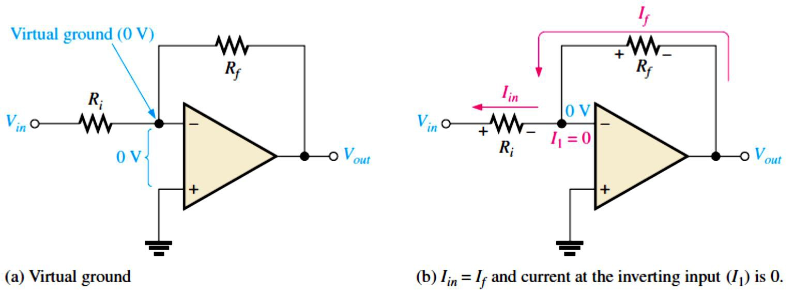
The closed-loop voltage gain of a noninverting amplifier is 1⁄� as previously derived. Since
� = 1 for a voltage-follower, the closed-loop voltage gain of the voltage-follower is
���(𝐕�) ^{= �}
Equation 12– 9
FIGURE 12-18: Op-amp voltage-follower.
Inverting Amplifier: It is shown in Figure 12-19, the input signal is applied through a series input resistor 𝑅_{𝑖}to the inverting (−) input. Also, the output is fed back through �_{𝑓}to the same input. The noninverting (+) input is grounded.
Since there is no current at the inverting input, the current through 𝑅_{𝑖}and the current through
�_{𝑓}are equal, as shown in Figure 12-20. 𝐼_{𝑖�} = �_{𝑓}
➢ Voltage gain: �_{��(𝐈)} = − 𝑹_{𝒇}⁄𝑹_{𝒊}
Equation 12– 10
The �_{��(I)} is independent of the op-amp’s internal open-loop gain. Thus, the negative feedback stabilizes the voltage gain. The negative sign indicates inversion.
FIGURE 12-19: Inverting amplifier.
FIGURE 12-20: Virtual ground concept and closed-loop voltage gain development for the inverting amplifier.

Slide 10
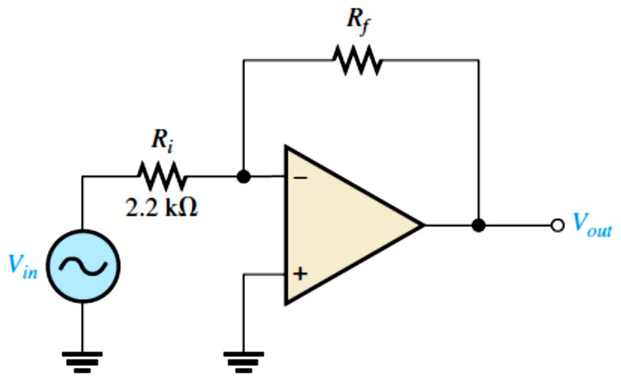
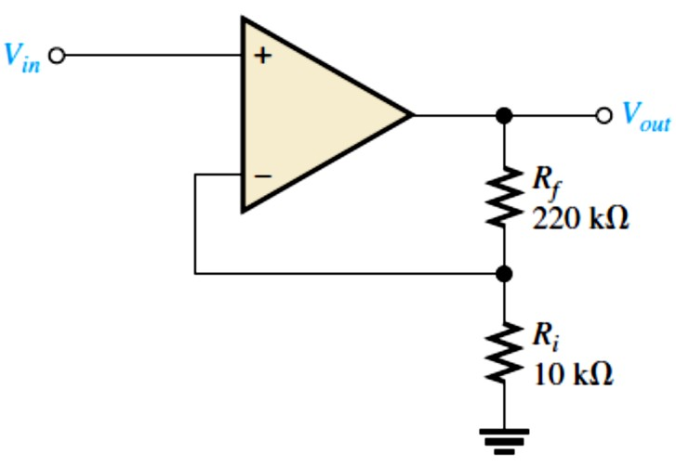
EXAMPLE 12-4: Given the op-amp configuration in Figure 12-21, determine the value of �_{𝑓} required to produce a closed-loop voltage gain of −100.
FIGURE 12-21
Solution Knowing that 𝑅_{𝑖}= 2.2 kΩ and the absolute value of the closed-loop gain is |�_{��(I)}| = 100,
we can calculate �_{𝑓}as follows:
|�_{��(I)}| = |− �_{𝑓}⁄𝑅_{𝑖}| = �_{𝑓}⁄𝑅_{𝑖}
�_{𝑓}= |�_{��(I)}|𝑅_{𝑖}= (100)(2.2 kΩ) = 220 kΩ
12.5 Effects of Negative Feedback on OP-AMP Impedances
Negative feedback affects the input and output impedances of an op-amp. The effects on both inverting and noninverting amplifiers are examined in this section.
Impedances of the Noninverting Amplifier: A noninverting amplifier configuration has a higher input impedance and a lower output impedance than the op-amp itself (without
feedback).
The overall input impedance of a closed-loop noninverting amplifier is
^{𝒁}𝒊�(��) ^{= (� + �}��^{�)𝒁}𝒊�
The output impedance of a noninverting amplifier is
^{𝒁}���(��) ^{= 𝒁}���^{⁄(� + �}��^{�)}
Equation 12– 11
Equation 12– 12
EXAMPLE 12-5: (a) Determine the input and output impedances of the amplifier in Figure 12-
22. The op-amp datasheet gives 𝑍_{𝑖�} = 2 MΩ, 𝑍��� = 75 Ω, and ��� = 200,000. (b) Find the closed-loop voltage gain.
FIGURE 12-22
Solution (a) The attenuation, B, of the feedback circuit is
� = 𝑅_{𝑖}⁄(𝑅_{𝑖}+ �_{𝑓}) = 10 kΩ⁄(10 kΩ + 220 kΩ) = 0.0435
𝑍_{𝑖�(NI)} = (1 + ��� �)𝑍_{𝑖�} = [1 + (200,000)(0.0435)](2 MΩ)
𝑍_{𝑖�(NI)} = 17.4 GΩ
This is such a large number that, for all practical purposes, it can be assumed to be infinite as in the ideal case.
𝑍_{���(NI)} = 𝑍��� ⁄(1 + ��� �) = 75 Ω⁄(1 + (200,000)(0.0435)) = 8.6 mΩ
This is such a small number that, for all practical purposes, it can be assumed to be zero as in the ideal case.
(b) �_{��(NI)} = 1 + (�_{𝑓}⁄𝑅_{𝑖}) = 1 + (220 kΩ⁄10 kΩ) = 23
10

Slide 11
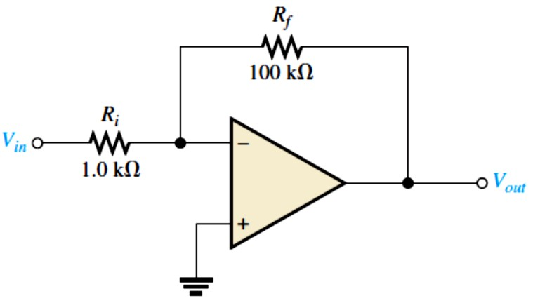
Voltage-Follower Impedances: The voltage-follower has the highest input impedance and the lowest output impedance of the three amplifier configurations.
  These features make it a nearly ideal buffer amplifier for interfacing high-impedance sources and low-impedance loads.
Since a voltage-follower is a special case of the noninverting amplifier configuration, the same
impedance formulas are used but with � = 1.
𝒁_{𝒊�(𝐕�)} = (� + ����)𝒁_{𝒊�} = (� + ���)𝒁_{𝒊�}
Equation 12– 13
^{𝒁}��� ^{𝒁}���
^{𝒁}���(VF) ⁼ _{� + �}
= Equation 12– 14
� � + �
�� ��
EXAMPLE 12-6: The op-amp in Example 12-5 is used in a voltage-follower configuration. Determine the input and output impedances.
Solution Since � = 1, 𝑍_{𝑖�(VF)} = (1 + ��� )𝑍_{𝑖�} = (1 + 200,000)(2 MΩ) ≅ 400 GΩ
𝑍_{���(VF)} = 𝑍��� ⁄(1 + ��� ) = 75 Ω⁄(1 + 200,000) = 375 𝜇Ω
𝑍_{𝑖�(VF)} is much greater than 𝑍_{𝑖�(NI)}, and 𝑍_{���(VF)} is much less than 𝑍_{���(NI)} from Example 12-5.
Impedances of the Inverting Amplifier: An inverting amplifier configuration has an input impedance approximately equal to the input resistor 𝑅_{𝑖}and an output impedance approximately equal to the output impedance of the op-amp itself.
The input impedance for an inverting amplifier is
^{𝒁}𝒊�(𝐈) ^{≅ 𝑹}𝒊
Equation 12– 15
The output impedance of an inverting amplifier is the same as for the noninverting case.
^{𝒁}���(𝐈) ^{= 𝒁}���^{⁄(� + �}��^{�)}
Equation 12– 16
The output impedance of both the noninverting and the inverting amplifier configurations is very low; in fact, it is almost zero in practical cases. Because of this near zero output impedance, any load impedance within limits can be connected to the op-amp output and not change the output voltage. The limits for the load impedance are determined by the maximum peak-to-peak swing of the output (�_{O(P−P)}) and the current limit of the op-amp.
EXAMPLE 12-7: Find the values of the input and output impedances in Figure 12-23. Also, determine the closed-loop voltage gain. The op-amp has the following parameters: ��� = 50,000
𝑍_{𝑖�} = 4 MΩ, and 𝑍��� = 50 Ω.
FIGURE 12-23
Solution 𝑍_{𝑖�(I)} ≅ 𝑅_{𝑖}= 1.0 kΩ
The feedback attenuation, B, is
� = 𝑅_{𝑖}⁄(𝑅_{𝑖}+ �_{𝑓}) = 1.0 kΩ⁄(1.0 kΩ + 100 kΩ) = 0.001

Slide 12
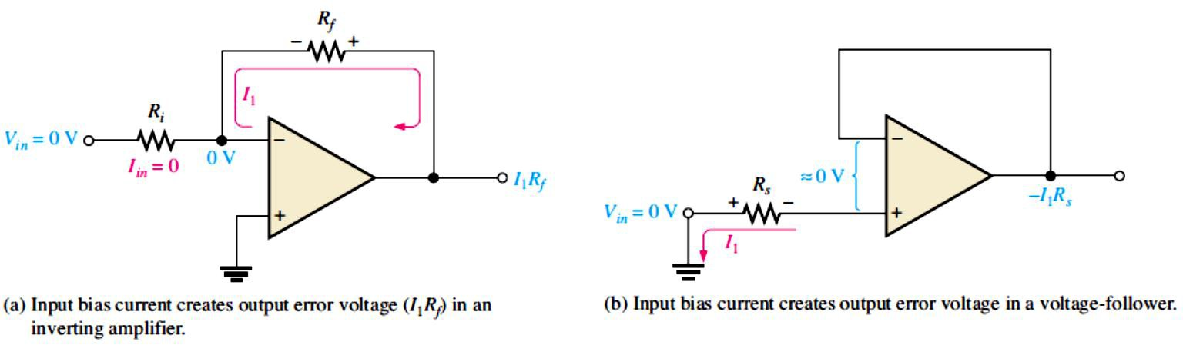
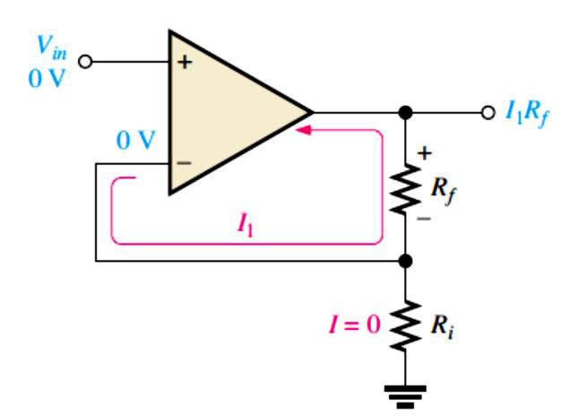
Then 𝑍_{���(I)} = 𝑍��� ⁄(1 + ��� �) = 50 Ω⁄(1 + (50,000)(0.001)) = 980 mΩ (zero for all practical purposes).
The closed-loop voltage gain is �_{��(I)} = − �_{𝑓}⁄𝑅_{𝑖}= − 100 kΩ⁄1.0 kΩ = −100
12.6 Bias Current and Offset Voltage
Certain deviations from the ideal op-amp must be recognized because of their effects on its operation.
Transistors within the op-amp must be biased so that they have the correct values of base and collector currents and collector-to-emitter voltages.
Effect of Input Bias Current: All practical op-amps have small input bias currents and input
offset voltages that produce small output error voltages as shwon in Figure 12-24 for an inverting amplifier and a voltage-follower and in Figure 12-25 for a noninverting amplifier.
FIGURE 12-24: Effects of bias currents.
FIGURE 12-25: Input bias current creates output error voltage in a noninvertingamplifier.
Bias Current Compensation: The input bias current effect can be compensated for with external resistors.
Voltage-Follower: The output error voltage due to bias currents can be sufficiently reduced by adding a resistor, �_{𝑓}, equal to the source resistance, 𝑅�, as shown in Figure 12-26.
The output error voltage is reduced as follows because 𝐼_{OS} is less than 𝐼₂.
�OUT(error) ^{= |�}1 ^{− 𝐼}2^{|𝑅}� ^{= 𝐼}OS^{𝑅}�
where 𝐼_{OS} is the input offset current.

Slide 13
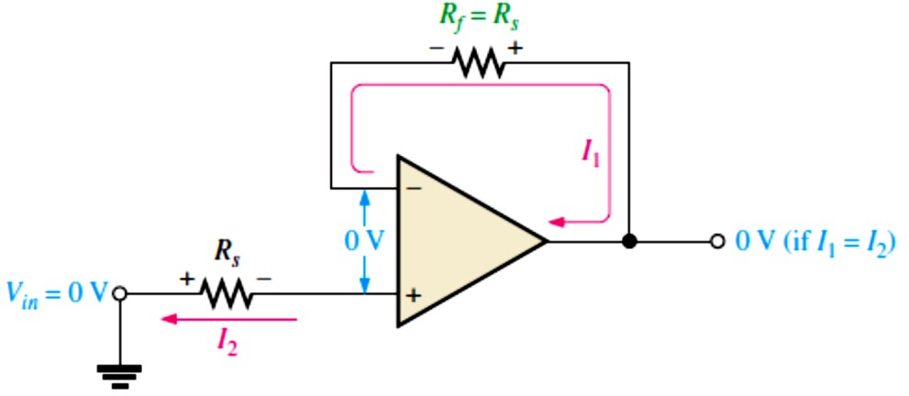
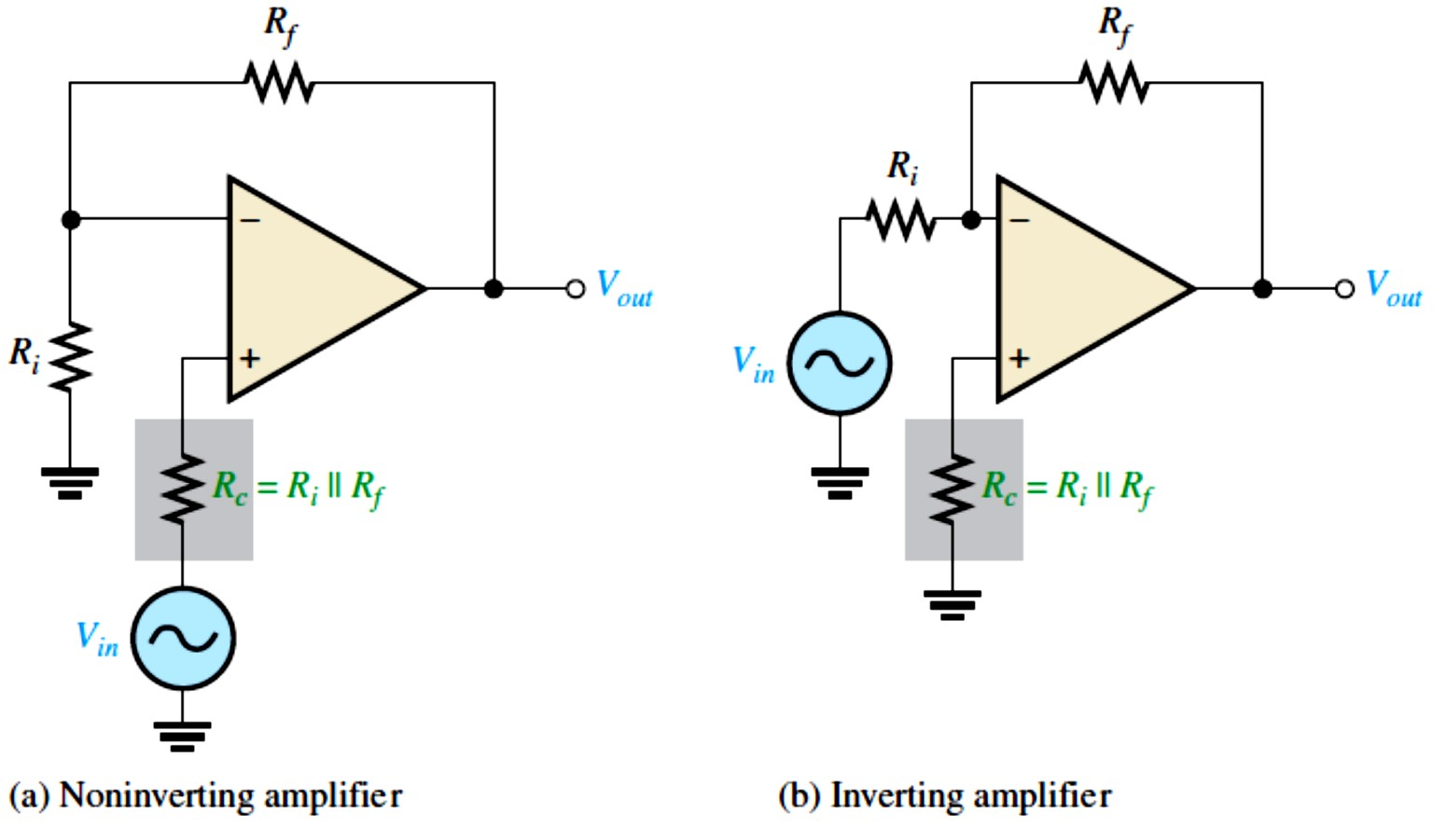
FIGURE 12-26: Bias current compensation in a voltage-follower.
Noninverting and Inverting Amplifiers: To compensate for the effect of bias current in the noninverting amplifier, a resistor 𝑅� is added, as shown in Figure 12-27.
The compensating resistor value equals the parallel combination of 𝑅_{𝑖}and �_{𝑓}.
FIGURE 12-27: Bias current compensation in the noninverting and inverting amplifier configurations.
Use of a BIFET Op-Amp to Eliminate the Need for Bias Current Compensation: The BIFET op-amp uses both BJTs and JFETs in its internal circuitry.
The JFETs are used as the input devices to achieve a higher input impedance than is possible with standard BJT amplifiers.
Because of their very high input impedance, BIFETs typically have input bias currents that are much smaller than in BJT op-amps, thus reducing or eliminating the need for bias current compensation.
Effect of Input Offset Voltage: The output voltage of an op-amp should be zero when the differential input is zero. However, there is always a small output error voltage present whose value typically ranges from microvolts to millivolts.
  This is due to unavoidable imbalances within the internal opamp transistors aside from the
bias currents previously discussed. In a negative feedback configuration, the input offset

Slide 14
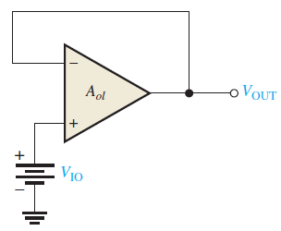
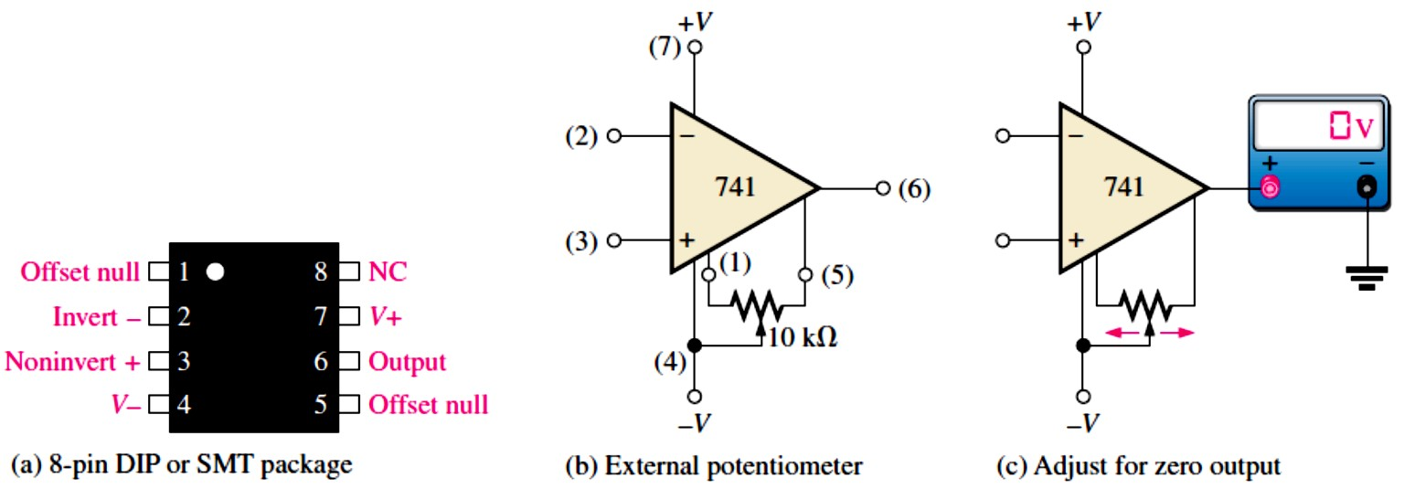
voltage �_{IO} can be visualized as an equivalent small dc voltage source, as illustrated in Figure 12-28 for a voltage-follower. Generally, the output error voltage due to the input offset voltage is
�OUT(error) ^{= �}�� �IO
For the case of the voltage-follower, ��� = 1, so
�OUT(error) ^{= �}IO
FIGURE 12-28: Input offset voltage equivalent.
Input Offset Voltage Compensation: The input offset voltage can be compensated for with an external potentiometer between the two offset null pins provided on the IC op-amp package and as recommended by the manufacturer, as illustrated in Figure 12-29(a) and (b) for a 741 op-amp.
The two terminals are labelled offset null. With no input, the potentiometer is simply adjusted until the output voltage reads 0, as shown in Figure 12-29(c).
FIGURE 12-29: Input offset voltage compensation for a 741 op-amp.
12.7 Open-Loop Frequency and Phase Responses
Open-loop responses relate to an op-amp with no external feedback.
The frequency response indicates how the voltage gain changes with frequency, and the phase response indicates how the phase shift between the input and output signal changes with frequency.
The open-loop gain, like the 𝛽of a transistor, varies greatly from one device to the next of the same type and cannot be depended upon to have a constant value.

Slide 15
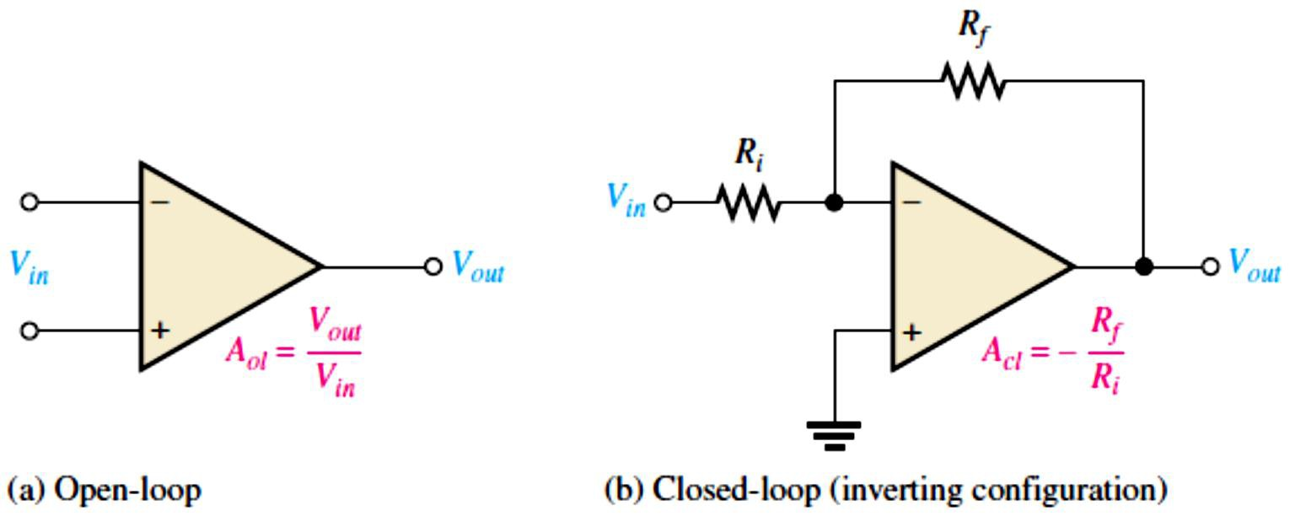
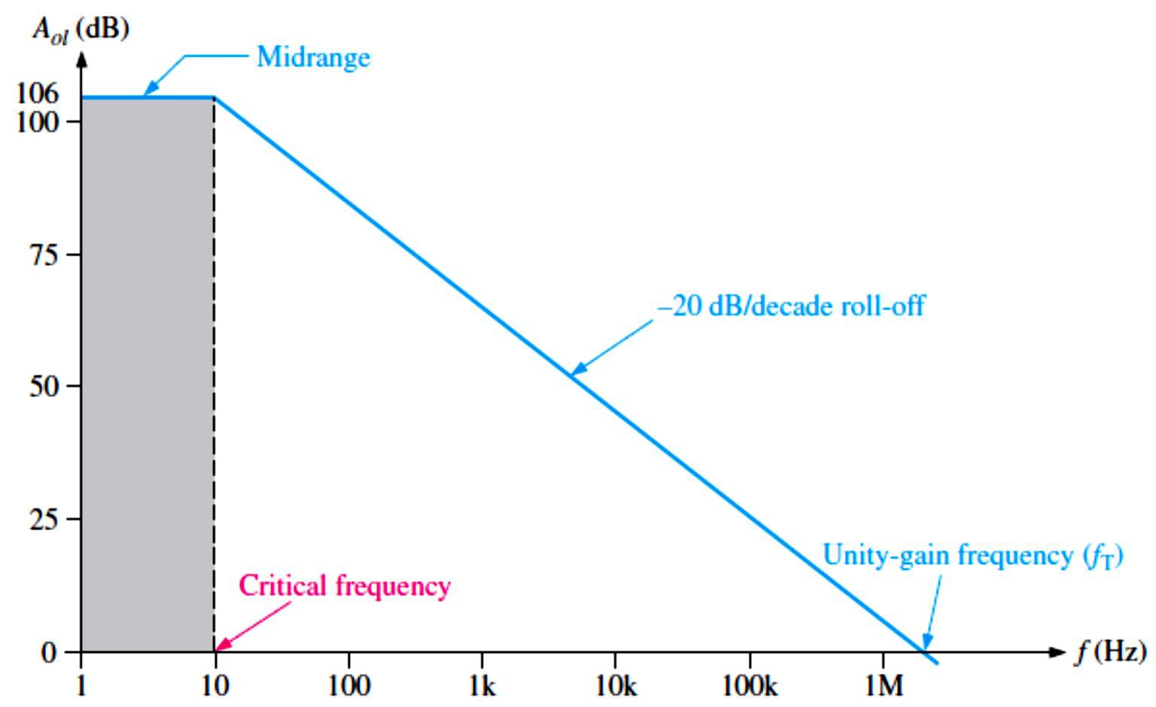
Review of Op-Amp Voltage Gains: The closed-loop voltage gain is determined by the external component values for an inverting amplifier configuration and is always less than the open-loop gain, as illustrated in Figure 12-30.
FIGURE 12-30: Open-
loop and closed-loop op- amp configurations.
Bandwidth Limitations: The midrange gain of an op-amp extends down to zero frequency (dc), as shown in Figure 12-31.
FIGURE 12-31: Ideal plot of open-loop voltage gain
versus frequency for a typical op-amp. The frequency scale is logarithmic.
3 dB Open-Loop Bandwidth: The bandwidth of an ac amplifier is the frequency range between the points where the gain is 3 dB less than the midrange gain.
In general, the bandwidth equals the upper critical frequency (���) minus the lower critical frequency (��� ).
�� = ��� − ���
Since ��� for an op-amp is zero, the bandwidth is simply equal to the upper critical frequency.
�� = 𝒇��
Equation 12– 17
From now on, we will refer to ��� as simply �� ; and we will use open-loop (ol) or closed-loop
(cl) subscript designators, for example, �_{�(��)}.

Slide 16
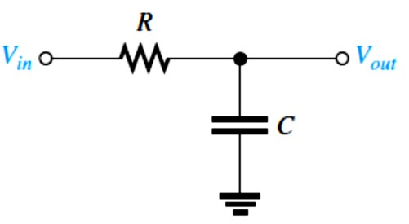
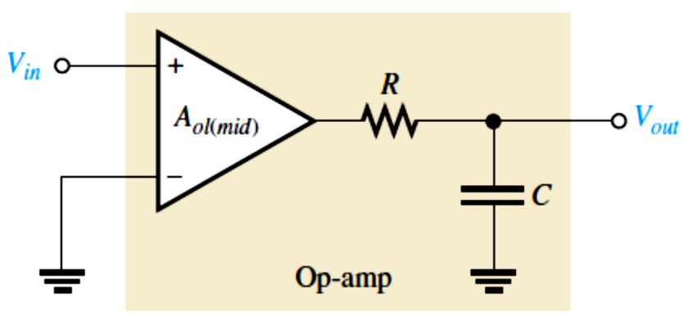
Unity-Gain Bandwidth: We notice in Figure 12-31 that the gain steadily decreases to a point where it is equal to unity (1 or 0 dB). The value of the frequency at which this unity gain occurs is the unity-gain frequency designated �_{𝑇}. �_{𝑇}is also called the unity-gain bandwidth.
Gain-Versus-Frequency Analysis: The gain of an op-amp decreases as frequency increases above the critical frequency.
The RC lag (low-pass) circuits within an op-amp are responsible for the roll-off in gain as the frequency increases, just as was discussed for the discrete amplifiers in Lecture 10.
From basic ac circuit theory, the attenuation of an RC lag circuit in terms of frequency, such as in Figure 12-32, is
����⁄�_{𝒊�} = �⁄(√� + 𝒇�⁄𝒇��)
Equation 12– 18
FIGURE 12-32: RC lag circuit.
If an op-amp is represented by a voltage gain element with a gain of �_{��(�𝑖�)} plus a single RC lag circuit, as shown in Figure 12-338, it is known as a compensated op-amp. The total open- loop gain of the op-amp is
��� = �_{��(�𝒊�)}⁄(√� + 𝒇�⁄𝒇��)
Equation 12– 19
FIGURE 12-33: Op-amp represented by a gain element and an internal RC circuit.
EXAMPLE 12-8: Determine ��� for the following values of 𝑓. Assume �_{�(��)} = 100 Hz and
�_{��(�𝑖�)} = 100,000. (a) 𝑓= 0 Hz (b) 𝑓= 10 Hz (c) 𝑓= 100 Hz (d) 𝑓= 1000 Hz
Solution (a)
��� = �_{��(�𝑖�)}⁄(√1 + 𝑓²⁄�_{𝐶(��)}²) = 100,000⁄(√1 + (0 Hz )²⁄(100 Hz)²) = 100,000
(b) ��� = 100,000⁄(√1 + (10 Hz )²⁄(100 Hz)²) = 99,503 (c) ��� = 100,000⁄(√1 + (100 Hz )²⁄(100 Hz)²) = 70,710 (d) ��� = 100,000⁄(√1 + (1000 Hz )²⁄(100 Hz)²) = 9950

Slide 17
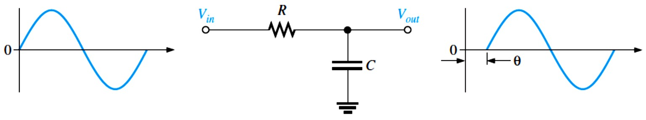
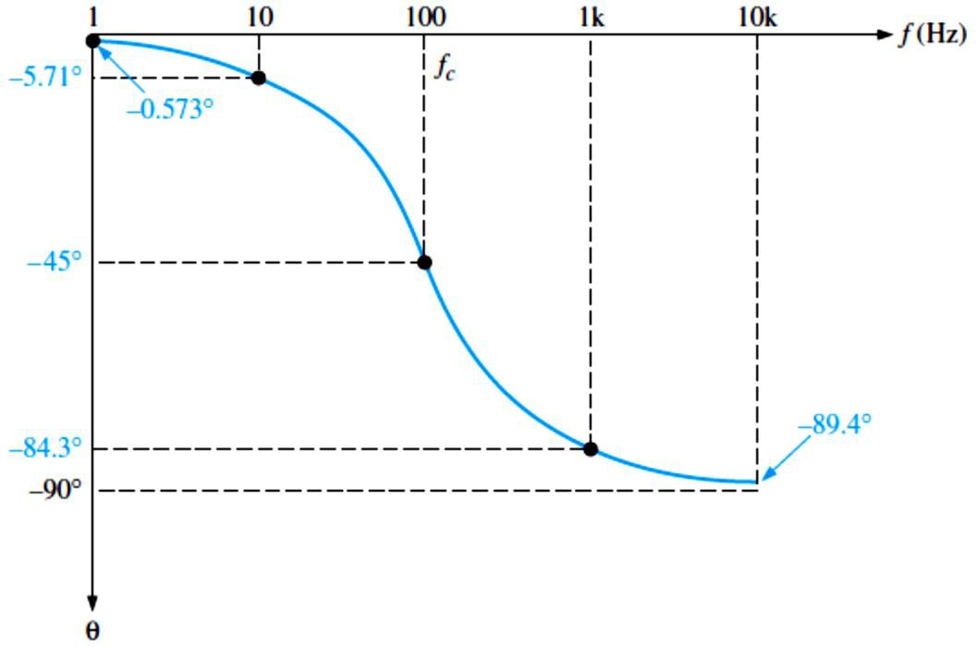
Phase Shift: As we know from Lecture 10, an RC circuit causes a propagation delay from input to output, thus creating a phase shift between the input signal and the output signal.
An RC lag circuit such as found in an op-amp stage causes the output signal voltage to lag the input, as shown in Figure 12-34. From basic ac circuit theory, the phase shift, 𝜃, is
𝜃= − tan⁻¹(𝑅⁄�_{𝐶})
Since 𝑅⁄�_{𝐶}= 𝑓⁄�� ,
𝜽= − 𝐭𝐚�^{−�}(𝒇⁄𝒇�)
Equation 12– 20
The negative sign indicates that the output lags the input. This equation shows that the phase shift increases with frequency and approaches −90° as 𝑓becomes much greater than �� .
FIGURE 12-34: Output voltage lags input voltage.
EXAMPLE 12-9: Calculate the phase shift for an RC lag circuit for each of the following frequencies, and then plot the curve of phase shift versus frequency. Assume �� = 100 Hz.
(a) 𝑓= 1 Hz (b) 𝑓= 10 Hz (c) 𝑓= 100 Hz (d) 𝑓= 1000 Hz (e) 𝑓= 10,000 Hz
Solution (a) 𝜃= − tan⁻¹(𝑓⁄�� ) = − tan⁻¹(1 Hz⁄100 Hz) = −0.573°
(b) 𝜃= − tan⁻¹(10 Hz⁄100 Hz) = −5.71°
(c) 𝜃= − tan⁻¹(100 Hz ⁄100 Hz) = −45°
(d) 𝜃= − tan⁻¹(1000 Hz ⁄100 Hz) = −84.3°
(e) 𝜃= − tan⁻¹(10,000 Hz ⁄100 Hz) = −89.4°
The phase shift-versus-frequency curve is plotted in Figure 12-35. The frequency axis is logarithmic.
FIGURE 12-35

Slide 18
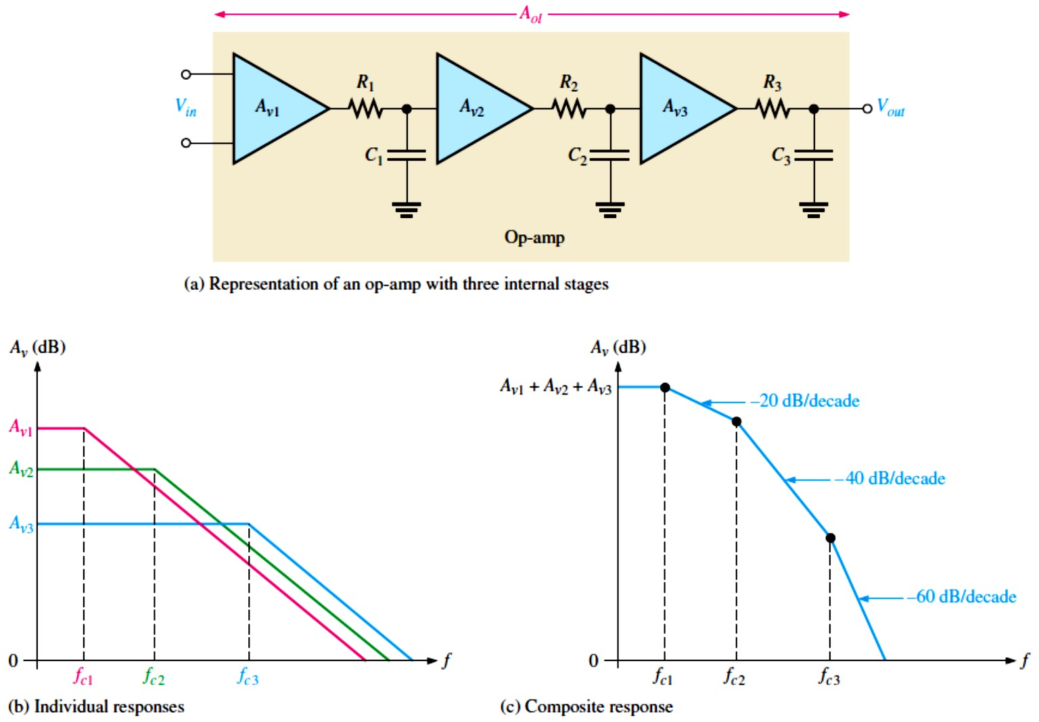
Overall Frequency Response: Previously, an op-amp was defined to have a constant roll-off of −20 dB/decade above its critical frequency.
The total response of an op-amp is a composite of the individual responses of the internal stages.
As an example, a three-stage opamp is represented in Figure 12-36. The dB gains are added.
Since the roll-off rates are additive, the total roll-off rate increases by −20 dB/decade as each critical frequency is reached.
FIGURE 12-36: Op-amp open-loop frequency response.
Overall Phase Response: In a multistage amplifier, each stage contributes to the total phase lag. Each RC lag circuit can produce up to −90° a phase shift.
Since each stage in an op-amp includes an RC lag circuit, a three-stage op-amp, for example, can have a maximum phase lag of −270°.
Also, the phase lag of each stage is less than −45° when the frequency is below the �� , equal to −45° at the �� , and greater than −45° when the frequency is above the �� .
The phase lags of the stages of an op-amp are added to produce a total phase lag for three
stages: 𝜃��� = − tan⁻¹(𝑓⁄�_{�1}) − tan⁻¹(𝑓⁄�_{�2}) − tan⁻¹(𝑓⁄�_{�3})

Slide 19
EXAMPLE 12-10: A certain op-amp has three internal amplifier stages with the following gains and critical frequencies: Stage 1: �_{�1} = 40 dB, �_{�1} = 2 kHz, Stage 2: �_{�2} = 32 dB, �_{�2} = 40 kHz, Stage 3: �_{�3} = 20 dB, �_{�3} = 150 kHz
Determine the open-loop midrange gain in decibels and the total phase lag when 𝑓= �_{�1}.
Solution �_{��(�𝑖�)} = �_{�1} + �_{�2} + �_{�3} = 40 dB + 32 dB + 20 dB = 92 dB
𝜃��� = − tan⁻¹(𝑓⁄�_{�1}) − tan⁻¹(𝑓⁄�_{�2}) − tan⁻¹(𝑓⁄�_{�3})
= − tan⁻¹(2 kHz⁄2 kHz ) − tan⁻¹(2 kHz⁄40 kHz) − tan⁻¹(2 kHz⁄150 kHz)
= −45° − 2.86° − 0.76° = −48.6°
12.8 Closed-Loop Frequency Response
Op-amps are normally used in a closed-loop configuration with negative feedback in order to
achieve precise control of the gain and bandwidth.
The midrange gain of an op-amp is reduced by negative feedback, as indicated by the following closed-loop gain expressions for the three amplifier configurations previously covered, where B is the feedback attenuation. For a noninverting amplifier,
�_{��(NI)} = ��� ⁄(1 + ��� �) ≅ 1⁄� = 1 + (�_{𝑓}⁄𝑅_{𝑖})
  For an inverting amplifier, �_{��(I)} = − �_{𝑓}⁄𝑅_{𝑖}
  For a voltage-follower, �_{��(VF)} = 1
Effect of Negative Feedback on Bandwidth: The closed-loop critical frequency, �_{�(��)}, of an op-amp is
^{𝒇}�(��) ^{= 𝒇}�(��)^{(� + ��}��(�𝒊�)⁾
Equation 12– 21
This expression shows that the �_{�(��)} is higher than the open-loop critical frequency �_{�(��)} by the factor 1 + ��_{��(�𝑖�)}.
Since �_{�(��)} equals the bandwidth for the closed-loop amplifier, the closed-loop bandwidth (���� ) is also increased by the same factor.
���� = ����(� + ��_{��(�𝒊�)})
Equation 12– 22
EXAMPLE 12-11: A certain amplifier has an open-loop midrange gain of 150,000 and an open- loop 3 dB bandwidth of 200 Hz. The attenuation (B) of the feedback loop is 0.002. What is the closed-loop bandwidth?
Solution ���� = ���� (1 + ��_{��(�𝑖�)}) = 200 Hz[1 + (0.002)(150,000)] = 60.2 kHz
When the open-loop gain of an op-amp is reduced by negative feedback, the bandwidth is increased, as shown in Figure 12-37.
The closed-loop gain is independent of the open-loop gain up to the point of intersection of the two gain curves. This point of intersection is the �_{�(��)} for the closed-loop response.
The closed-loop gain has the same roll-off rate as the open-loop gain, beyond the �_{�(��)}.

Slide 20
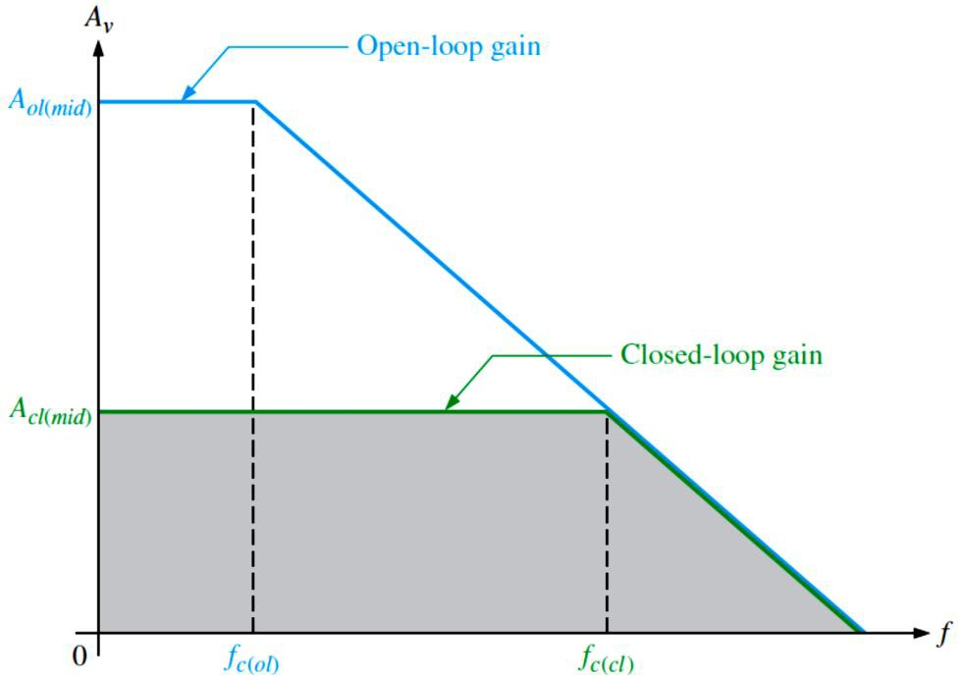
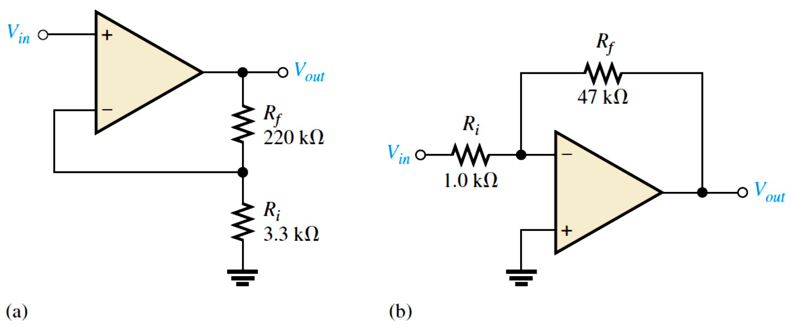
FIGURE 12-37:Closed -loop gain compared to open-loop gain.
Gain-Bandwidth Product: An increase in closed-loop gain causes a decrease in the bandwidth and vice versa, such that the product of gain and bandwidth is a constant.
The gain-bandwidth product is always equal to the frequency at which the op-amp’s open- loop gain is unity or 0 dB (unity-gain bandwidth, �_{𝑇}).
^{𝒇}𝑻^{= �}��^{𝒇}�(��)
Equation 12– 23
EXAMPLE 12-12: Determine the bandwidth of each of the amplifiers in Figure 12-38. Both op- amps have an open-loop gain of 100 dB and a unity-gain bandwidth (�_{𝑇}) of 3 MHz.
FIGURE 12-38
Solution (a) For the noninverting amplifier in Figure 12-38(a), the closed-loop gain is
��� = 1 + (�_{𝑓}⁄𝑅_{𝑖}) = 1 + (220 kΩ⁄3.3 kΩ) = 67.7
�_{�(��)} = ���� = �_{𝑇}⁄��� = 3 MHz⁄67.7 = 44.3 kHz, ���� = 44.3 kHz
(b) For the inverting amplifier in Figure 12-38(b), the closed-loop gain is
��� = − �_{𝑓}⁄𝑅_{𝑖}= − 47 kΩ⁄1.0 kΩ = −47
Using the absolute value of ��� , the closed-loop bandwidth is
�_{�(��)} = ���� = �_{𝑇}⁄��� = 3 MHz⁄47 = 63.8 kHz, ���� = 63.8 kHz
20

